Slide 1
Practice session: Introduction to r
Advanced Statistics
Ilham Fadhil N., Santi Novani, Dianadewi R.

Slide 2

How to work with data
Imagine you are a carpenter. You want to create a state of the art sculpture. What are the required things you should know and master to accomplish your goal?
Notes:
Master the tool and skill. Not only on theory, skill required the artist able to implement theory into practical use. Thus, like the carpenter, in statistical analyst exercise is very important to achieve mastery. Skill made of two fundamental concept, theory and practice.

Slide 3
How to work with data
Obtain the data
Prepare the data
Explore the data
Analyze the data
Communicate the result

Slide 4

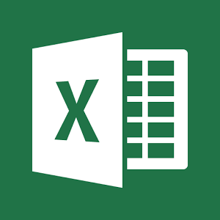




Statistical software
And many more….
Notes:
Software is not the tool, your understanding of the statistical process and analysis is the tool. Not only statistical software but more to data analysis software

Slide 5

What is R?
R is a language and environment for statistical computing and graphics. It is a GNU project which is similar to the S language and environment which was developed at Bell Laboratories (formerly AT&T, now Lucent Technologies) by John Chambers and colleagues
Creator: Ross Ihaka and Robert Gentleman, University of Auckland, New Zealand and the R foundation
Year released : 1995

Slide 6
Why R?
Purpose and usability
R has been used in academics and research for a long time. Today, its fining its way into commercial applications as well. See R as the open-source counterpart of SAS
R has advanced graphical capabilities thanks to for examples packages like ggplot2, googleVis, and rCharts
Due to its open-source nature, R has a large and supportive community. The latest techniques are developed and released quickly
Learn the nut and bolts of the statistical analysis rather than using one solution for all approach
Notes:
Kebebasan buat menggunakan alat

Slide 7
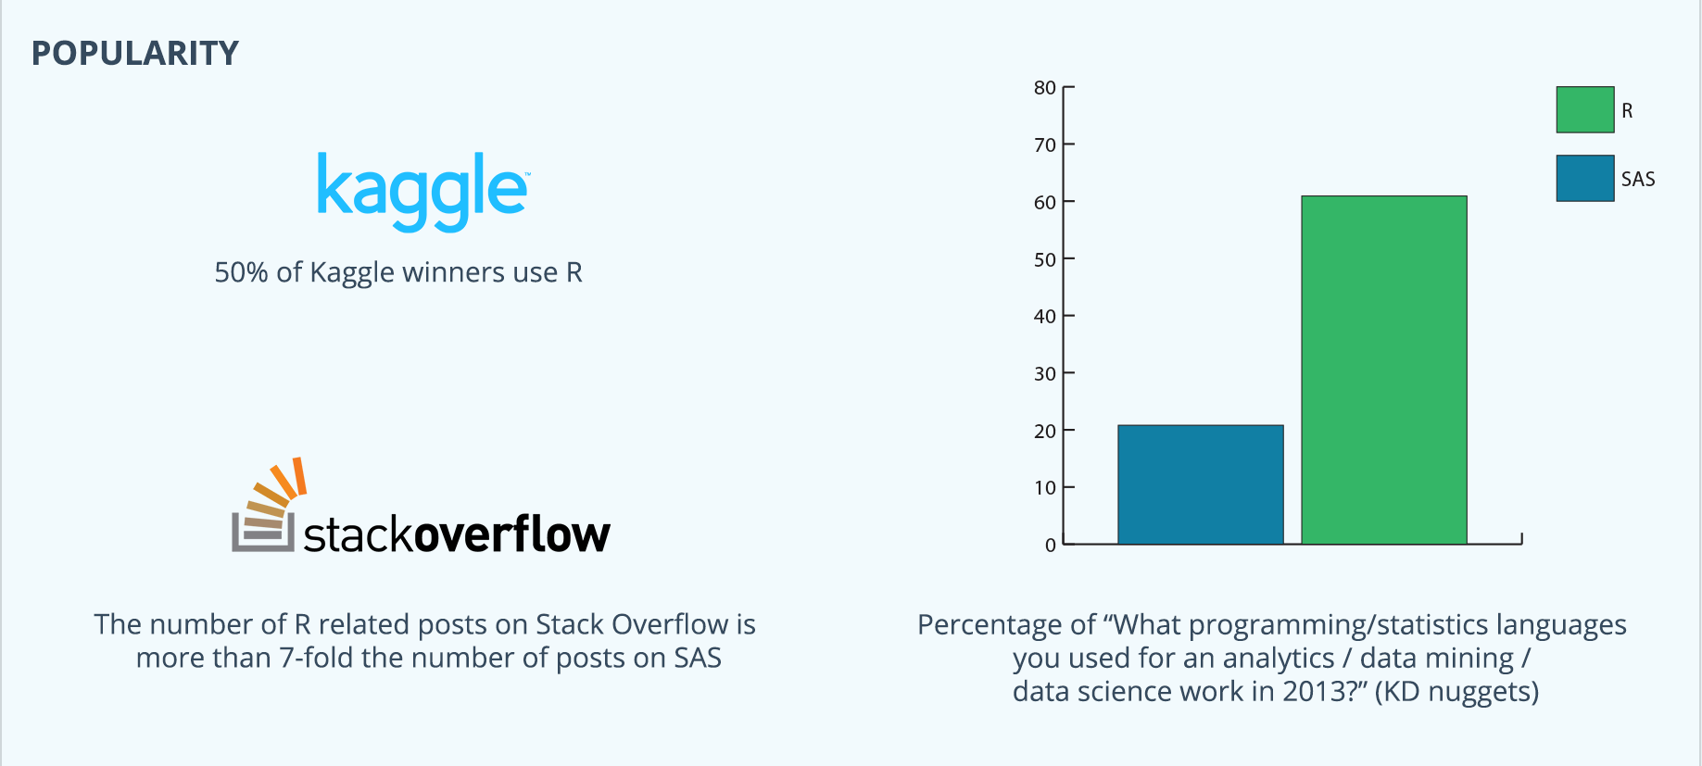
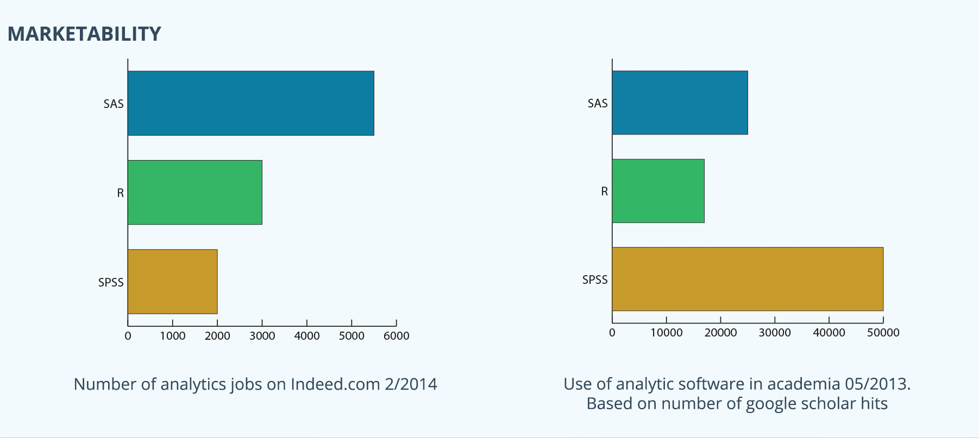
Why R?

Slide 8
Requirement
Install R (link) : https://www.r-project.org
Install Rstudio desktop (link) : http://www.rstudio.com/ide
Reference
R-function list: https://statisticsglobe.com/r-functions-list/

Slide 9
Rstudio environment introduction
Data type
Basic command
Data import
Looking at the data
Visualizing the data
Today’s topic

Slide 10
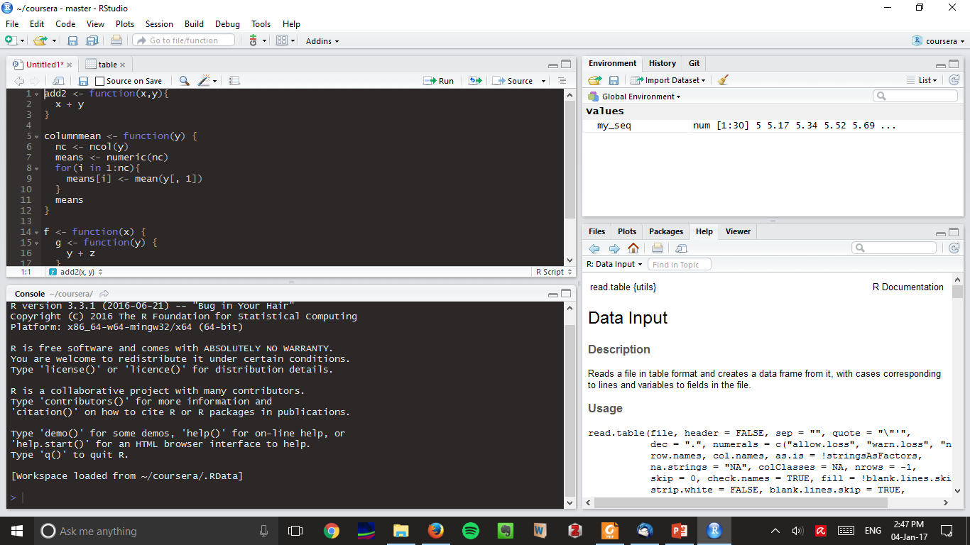
RStudio environment
script
Workspace
Tab section
console
Notes:
2 way to execute the command in R. Through script or console

Slide 11
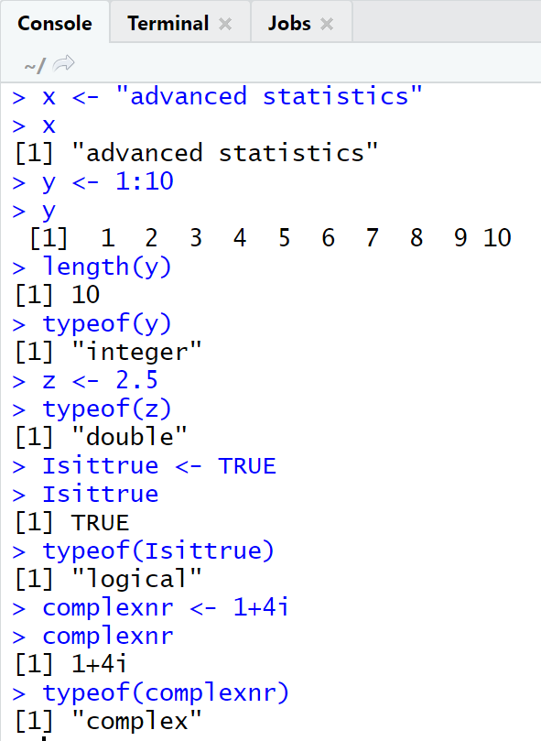
Data type
Basic data type:
character: "a", "swc"
numeric (real or decimal) : 2, 15.5
integer: 2L (the L tells R to store this as an integer)
logical: TRUE, FALSE
complex: 1+4i (complex numbers with real and imaginary parts)
Examples…

Slide 12
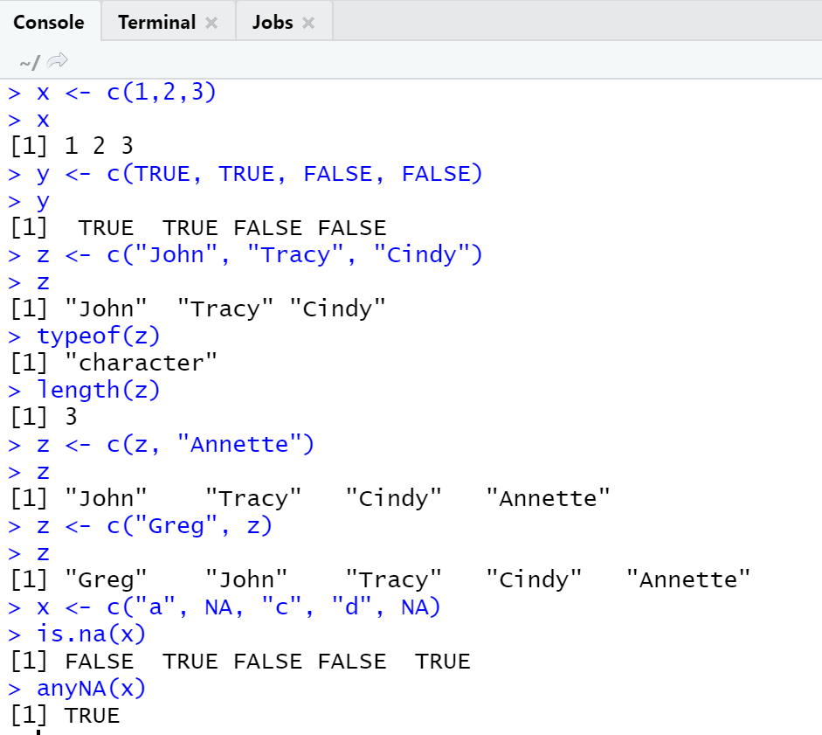
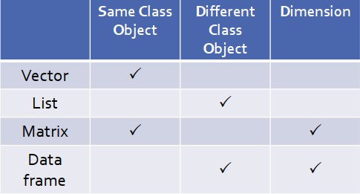
Data Structures
Vector
Data structures in R:
(atomic) vector
list
matrix
data frame
Examples….

Slide 13
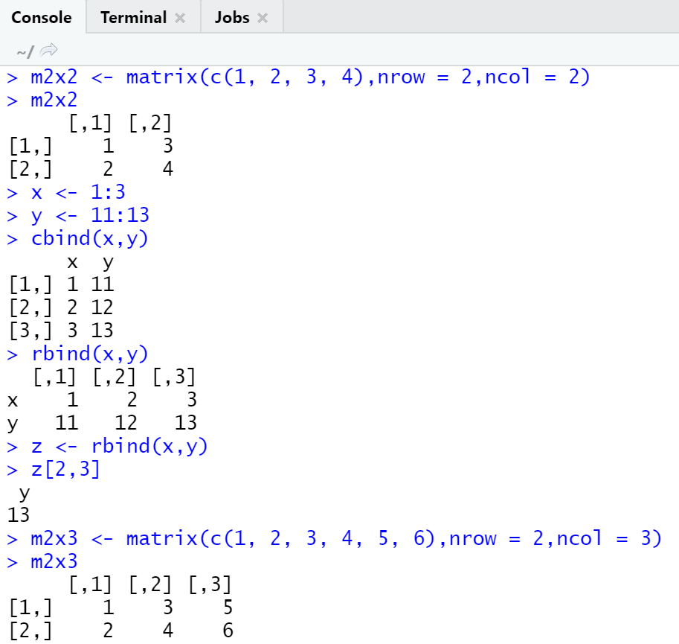
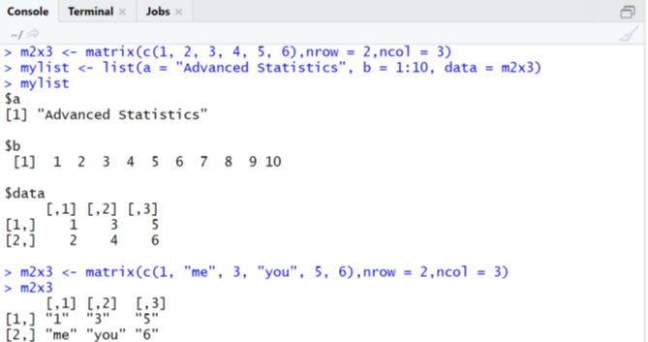
Matrix
List

Slide 14
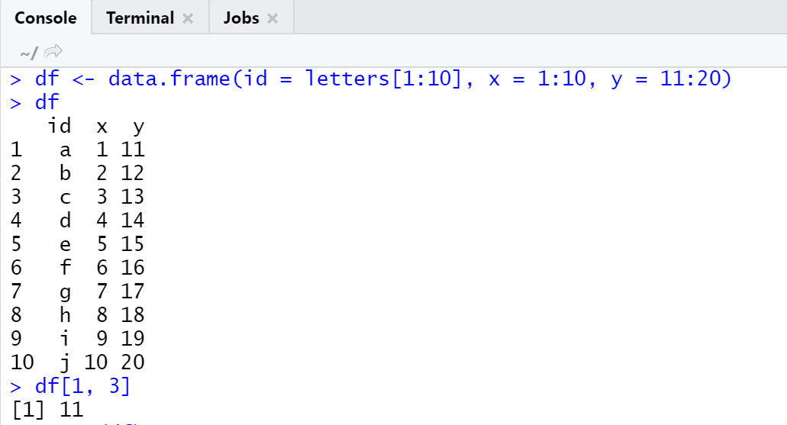
Data frame
Functions:
head() - shows first 6 rows
tail() - shows last 6 rows
dim() - returns the dimensions of data frame
nrow() - number of rows
ncol() - number of columns
str() - structure of data frame - name, type and preview of data in each column
names() or colnames() - both show the names attribute for a data frame

Slide 15
Basic command
Assignment notation
object <- command
object = command
Create vector
x <- vector(“numeric”, length = 10 )
Create list
x <- list( TRUE, 1, “a”)
Create matrix
rbind( )
cbind( )
Pull up a documentation file
?read.csv
Argumentation
args(read.csv)
Delete object
rm( object )

Slide 16
Data import
File type (.xls, .csv, .txt, etc)
Command :
read.table (file, header = FALSE, sep = "", dec = ".")
read.csv (file, header = TRUE, sep = ",", dec = ".")

Slide 17
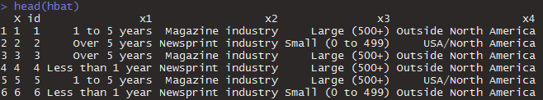
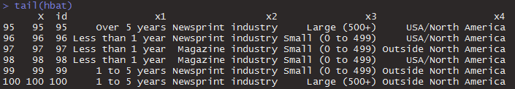

Looking at data

Slide 18
Looking at data
Class
For examine the type of the object
class (object)
Head
Obtain the first several rows of a matrix or data frame
head (object, ...)
Tail
Obtain the last several rows of a matrix or data frame
tail (object, ...)
Check for missing data
is.na(x)

Slide 19




Looking at data

Slide 20
Looking at data
dim
Retrieve or set the dimension of an object.
dim(object)
nrow and ncol
nrow and ncol return the number of rows or columns
nrow(object)
ncol(object)
Table
cross-classifying factors to build a contingency table of the counts at each combination of factor levels
table(object$variable1, object$variable2)

Slide 21
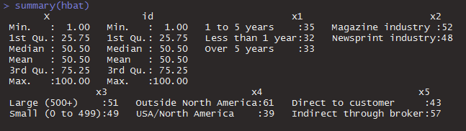
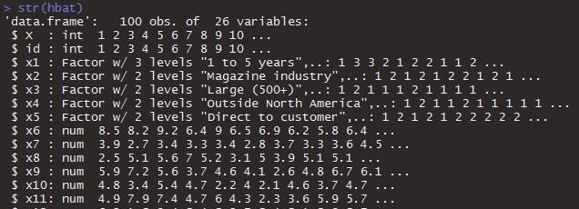
Looking at data

Slide 22
Looking at data
summary
Provide brief descriptive statistics on the data frame or matrix
summary (object, ...)
str
Compactly display the internal structure of an R object
str (object, ...)

Slide 23
Visualizing data
Histogram
Scatter plot
Box plot
Data distribution

Slide 24
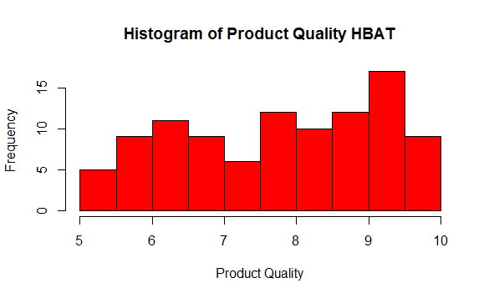
Visualizing data
Histogram
hist(x, xlab = " ", main = " ", col = " ")

Slide 25
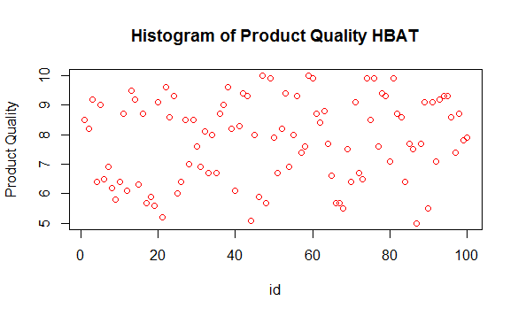
Visualizing data
Scatter Plot
plot(x, xlab = " ", ylab = " ",main = " ", col = " ")

Slide 26
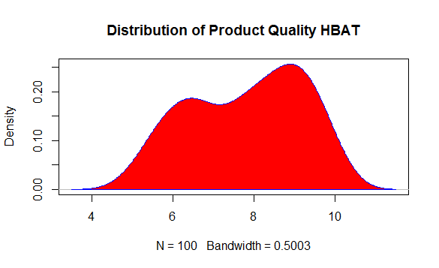
Visualizing data
Data distribution
plot(density(x), xlab = " ", ylab = " ", main = " ", col = " ")
polygon(density(x), xlab = “ ", ylab = “ ", main = “ ", col = “ ")

Slide 27
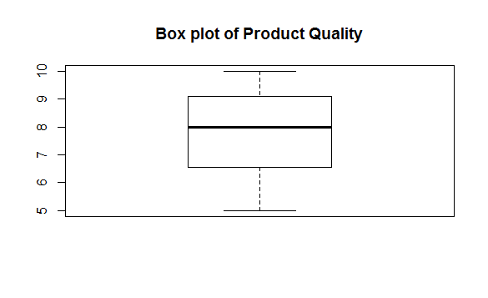
Visualizing data
Box plot
boxplot(x, xlab = " ", ylab = " ",main = " ", col = " ")

Slide 28
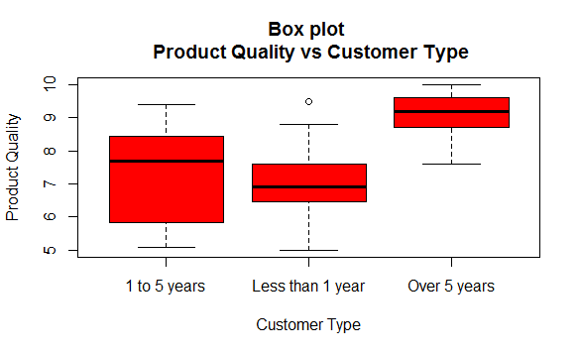
Visualizing data

Slide 29
More complex commands and function
Create subset
object[…]
Subset( )
For loop (iterasi)
for (… in …) { … }
Apply function to data frame
apply(x, margin, function)
Margin 1 is row, margin 2 is column
Create matrix
matrix(seq(), … )
matrix(rep(), … )
More about applying function to data frame
lapply()
sapply()
tapply()
mapply()
Create function
function name <- function(…) { … }
Rescale data (how to rescale to become between 0 and 1 for each column?
See the exercise

Slide 30
Thank you

